Slide 1
Accident Prevention with Built-in Alcohol Detection Using IoT
DONE BY : HARSHAD S , NITIN PRANAV T S and VISHRANTH M S K

Slide 2
Introduction
Drunk driving accidents have become a major concern in today's society, causing significant loss of lives and property damage. This problem arises when individuals choose to operate a vehicle while under the influence of alcohol, impairing their ability to drive safely.
Developing advanced technologies, such as ignition interlock devices that prevent a vehicle from starting if the driver's blood alcohol concentration exceeds a certain limit, can prove effective in deterring drunk driving.
Finding innovative solutions to prevent drunk driving accidents is crucial as it not only saves lives but also reduces societal costs. The use of technology and stricter enforcement of laws can make a profound impact in curbing this issue. By prioritizing the development and implementation of these solutions, we can move towards a safer future where drunk driving accidents become increasingly rare.

Slide 3
Overview of IoT technology
IoT, or the Internet of Things, refers to the interconnection of different physical devices and objects through the internet. These devices, equipped with sensors, software, and network connectivity, can collect and exchange data with each other, enabling them to interact and perform certain tasks without human intervention.
In transportation, IoT has revolutionized various aspects, enhancing efficiency, safety, and convenience. Some examples of IoT applications in transportation include:
Smart Traffic Management: IoT enables the collection and analysis of real-time traffic data from multiple sources, such as sensors embedded in roads, vehicles, and traffic lights. This data can be used to optimize traffic flow, detect congestion, and manage traffic signals to improve overall transportation efficiency.
Intelligent Fleet Management: IoT allows tracking and monitoring of vehicles using GPS and sensor technologies. This helps fleet managers optimize routes, monitor fuel consumption, schedule maintenance, and increase safety by identifying risky behaviors like harsh braking or speeding.
Overall, IoT applications in transportation and safety enhance efficiency, provide real-time data insights, improve traffic flow, and most importantly, enhance safety by enabling proactive monitoring and response capabilities.

Slide 4
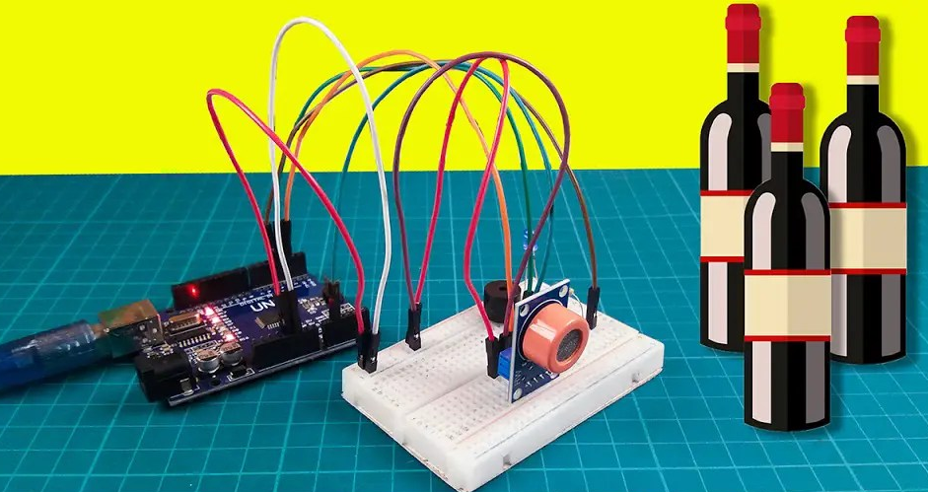
Accident Prevention with Built-in Alcohol Detection
The principles and technology used in IoT-based accident prevention systems with integrated alcohol detection are thoroughly examined . The integration of sensors for alcohol detection into automobiles, data transmission methods, onboard processing and decision-making algorithms,
and connectivity with external networks are all covered. To give a thorough grasp of the system architecture, the working theories and functionalities of various components are explored.

Slide 5
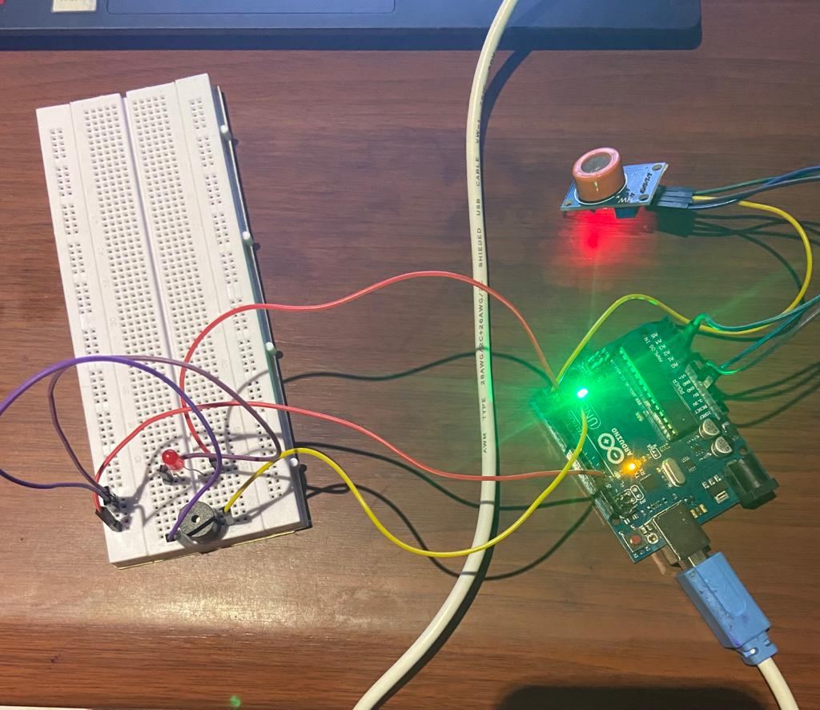
Functioning of the Built-in Alcohol Detection System
This project is divided into two parts –Prevention part and detection part.
In the prevention part, we will be implementing an alcohol detection system and a seatbelt detection system. Only if there is no alcohol detected from the driver and the seatbelt is fastened, the car will be able to move from the relay module connected.
In the detection phase, a vibration sensor is attached to work. If a crash occurs, the sensor will detect it, and which will in turn be notified by an SMS sent to a pre-specified number.
In this way, we might be able to prevent any accidents that occur due to drunken driving, as well as detecting if the seatbelt is put on or not.
And in case, if an accident occurs, the emergency services will be informed immediately.

Slide 6
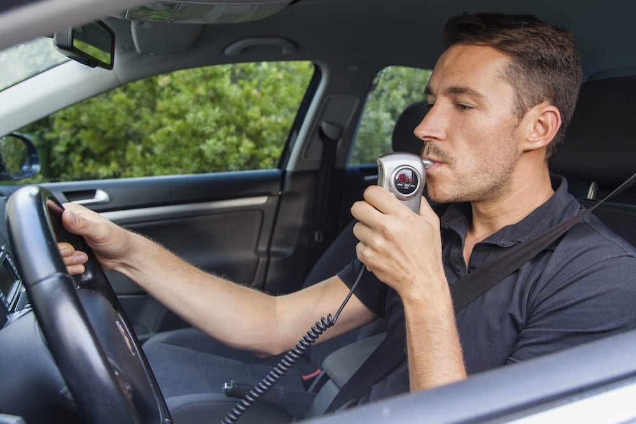
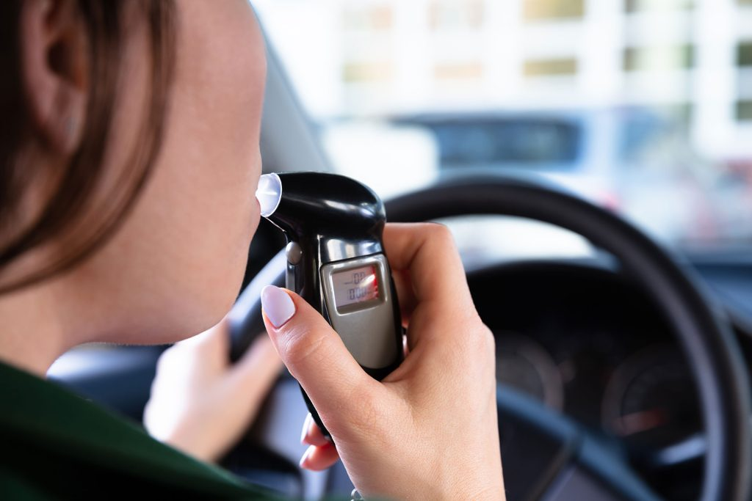
Benefits of the Built-in Alcohol Detection System
IoT-based accident prevention systems with integrated alcohol detection have many uses and advantages. This section investigates their possible application in a variety of vehicle types, including private automobiles, business fleets, public transportation, and emergency services. In the context of preventing accidents and enhancing general road safety, these systems' advantages—such as real-time alcohol monitoring, automatic notifications, and intervention capabilities—are explored.

Slide 7
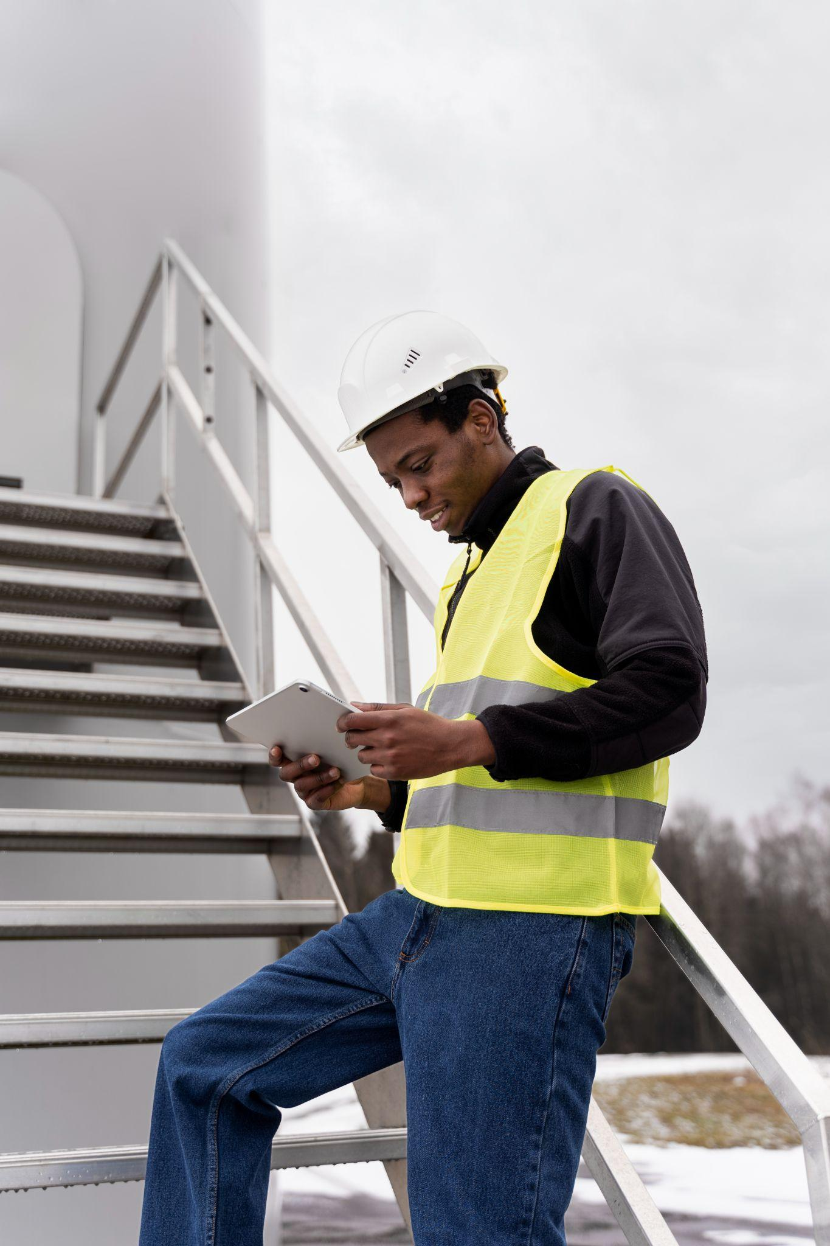
Challenges and Future Developments
The use of IoT-based accident prevention systems with integrated alcohol detection comes with a number of difficulties and restrictions. The main challenges are discussed in this part, such as sensor accuracy, dependability, calibration, and environmental conditions. Additionally, it exposes issues with user acceptance, data security, privacy worries, and system integration. The methods for overcoming these difficulties are examined, including information on potential remedies and directions for further study..

Slide 8
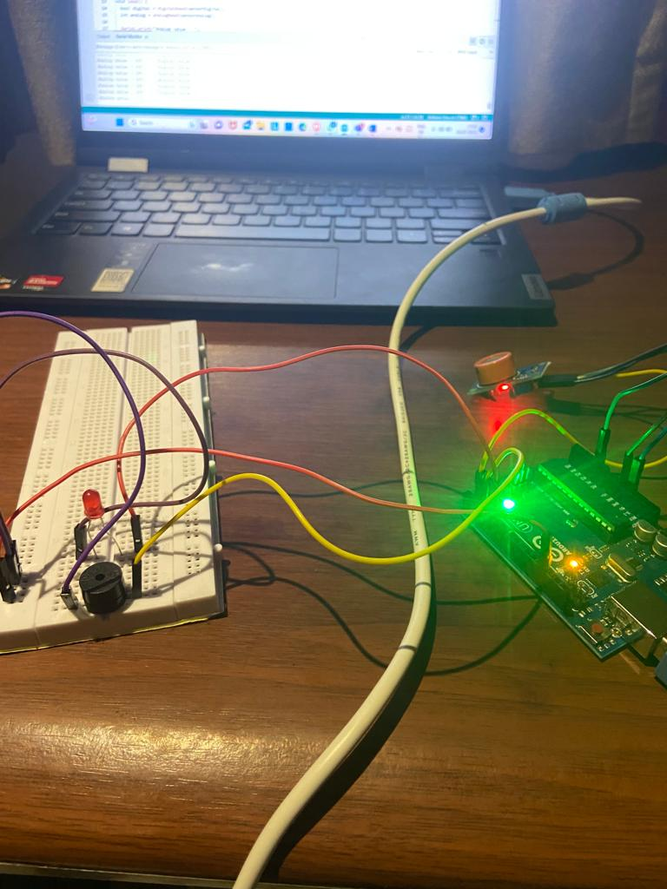
CONCLUSION
This study offers a thorough analysis of IoT-based accident prevention systems with integrated alcohol detection. These systems have the potential to drastically lower alcohol-related accidents and improve road safety by incorporating alcohol detecting capabilities into automobiles. Despite obstacles and constraints, ongoing research and breakthroughs in technology can get over them. Utilizing IoT, AI, and data analytics to produce more intelligent and effective accident prevention systems is one of the field's future goals.

